Slide 1

Data Analysis with Python
Ashish Patel
Principal Data Scientist and Author of Hands-on time series Analysis with python
/ashishpatel2604

Slide 2
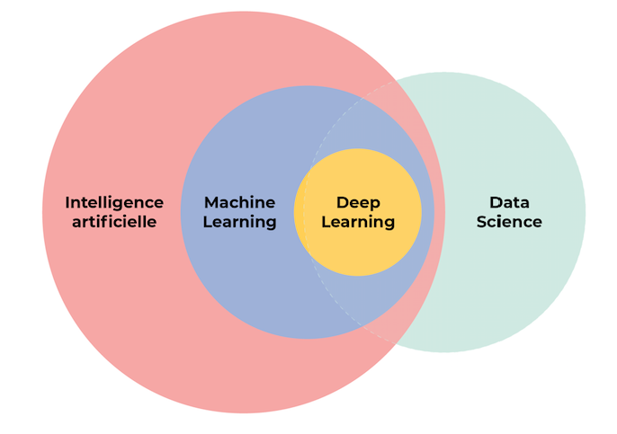
DATA SCIENCE
Data science is a concept used to tackle big data and includes data cleansing, preparation, and analysis.
Artificial intelligence is about using data to impart human-like decision making to machines.

Slide 3
MACHINE LEARNING
Machine Learning is a technique of data science that helps computers learn from existing data in order to forecast future behaviors, outcomes and trends.
TASK | DEFINITATION | EXAMPLE
Classification | predict what category new instance belongs to | is the tumor malign/benign?
Regression | predict a continuous numeric value | predict house/stock prices in future
Anomaly Detection | identify outliers | fraud detection
Clustering | separate similar data points into groups | customer segmentation

Slide 4
Terminology
Feature: also known as Attribute/ Independent Variable/ Predictor/ Input Variable. It's an individual measurable property/characteristic of a phenomenon being observed . The age of a person, etc.
Target: also known as Dependent Variable/ Response Variable/ Output Variable. It's the variable being predicted in supervised learning.
Algorithm: the specific procedure used to implement a particular ML technique. Linear Regression, etc.
Model: the algorithm applied to a dataset, complete with its settings (its parameters). Y=4.5x+0.8, etc. We want the model that best captures the relationship between features and the target.

Slide 5
Supervised learning : train the model with labeled data to generate reasonable predictions for the response to new data
Unsupervised learning : train the model with un-labeled data to find intrinsic structures/ patterns within the data.
Reinforcement learning: the model is learned from a series of actions by maximizing a reward function, which can either be maximized by penalizing bad actions and/or rewarding good actions. Selfdriving, etc.

Slide 6
Data Exploration
Variables : any measurable property/characteristic of a phenomenon being observed. They are called 'variables' because the value they take may vary (and it usually does) in a population.
Types of Variable : Categorical and Numerical

Slide 7
Type | Sub-Type | Definition | Example
Categorical | Nominal | Variables with values selected from a group of categories, while not having any kind of natural order. | Gender, car types
 | Ordinal | A categorical variable whose categories can be meaningfully ordered. | Grade of an exam
Numerical | Discrete | Variables whose values are either finite or countably infinite. | Number of children in a family
 | Continuous | Variable which can take on infinitely many, uncountable values. | House prices, time passed

Slide 8
Variable Identification: Identify the data types of each variable.
Univariate Analysis : Descriptive statistics on one single variable.
(Categorical Shape: Histogram/ Frequency table...)
(Numerical Central Tendency: Mean/ Median/ Mode, Dispersion: Min/ Max/ Range/ Quantile/ IQR/ MAD/ Variance/ Standard Deviation, Shape: Skewness/ Histogram/ Boxplot... )
Bi-variate Analysis Descriptive statistics between two or more variables. (Scatter Plot, Correlation Plot, and Heat Map)

Slide 9
Feature Cleaning

Slide 10
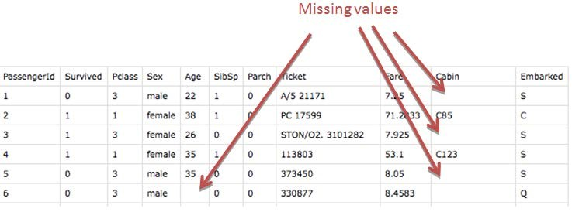
Missing Values
No value is stored in a certain observation within a variable.

Slide 11
Ways to handle Missing Data:
Method | Def
Listwise Deletion | excluding all cases (listwise) that have missing values.
Mean/Median/Mode Imputation | replacing the NA by mean/median/most frequent values (for categorical feature) of that variable.
Random Imputation | replacing the NA by taking a random value from the pool of available observations of that variable.
End of distribution Imputation | replacing the NA by values that are at the far end of the distribution of that variable, calculated by mean + 3*std

Slide 12
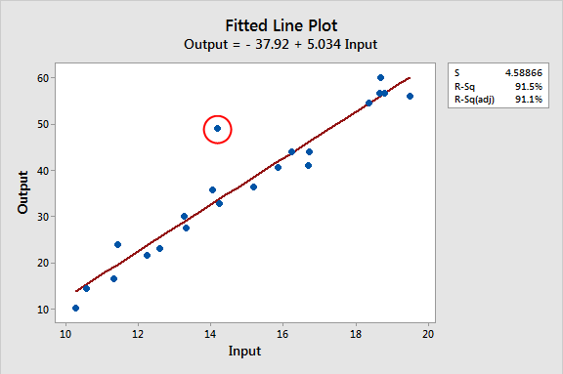
Outliers:
An outlier is an observation which deviates so much from the other observations as to arouse suspicions that it was generated by a different mechanism.

Slide 13
Ways to handle Outliers:
Method | Def
Mean/Median/Mode Imputation | replacing the outlier by mean/median/most frequent values of that variable.
Imputation with arbitrary value | impute outliers with arbitrary value.
Discard outliers | drop all the observations that are outliers.
Windsorization | top-coding & bottom coding (capping the maximum of a distribution at an arbitrarily set value, vice versa).

Slide 14
Special values:
Numeric variables are endowed with several formalized special values including ±Inf, NA and NaN. Calculations involving special values often result in special values and need to be handled/cleaned.
Obvious inconsistencies:
A person's age cannot be negative; a man cannot be pregnant, and an under-aged person cannot possess a drivers license.

Slide 15
Feature Engineering

Slide 16
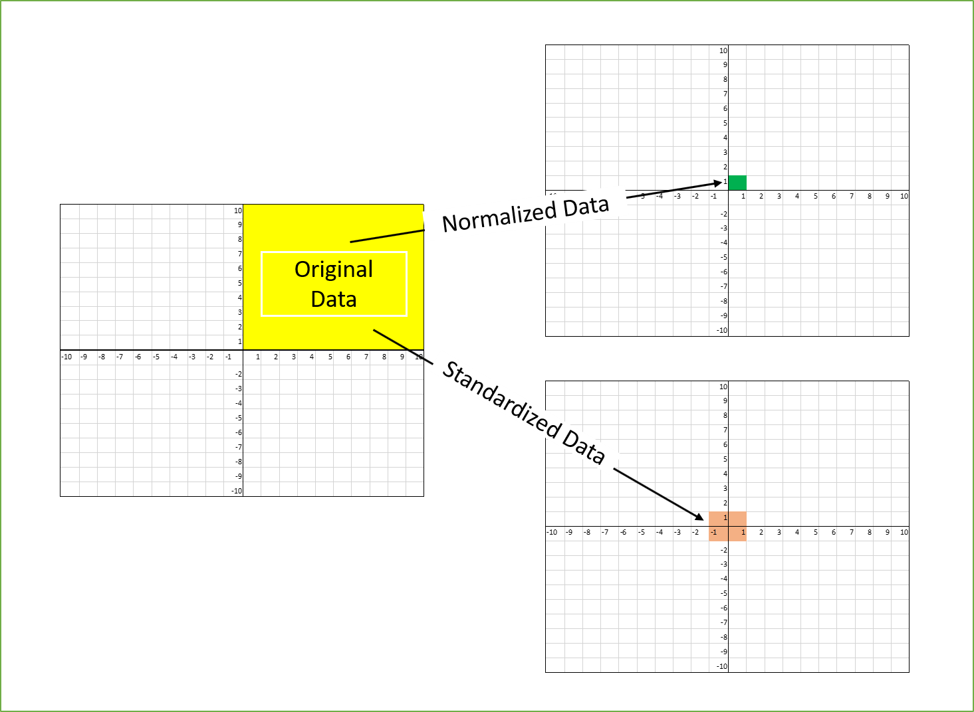
Feature Scaling
Feature scaling is a method used to standardize the range of independent variables or features of data. In data processing, it is also known as data normalization and is generally performed during the data preprocessing step.

Slide 17
How to Handle Feature Scaling:
Method | Def
Normalization - Standardization (Z-score scaling) | removes the mean and scales the data to unit variance. z = (X - X.mean) / std
Min-Max scaling | transforms features by scaling each feature to a given range. Default to [0,1]. X_scaled = (X - X.min / (X.max - X.min)
Robust scaling | removes the median and scales the data according to the quantile range (defaults to IQR) X_scaled = (X - X.median) / IQR

Slide 18
Feature Encoding

Slide 19
Feature Encoding:
We must transform strings of categorical variables into numbers so that algorithms can handle those values. Even if you see an algorithm can take into categorical inputs, it's most likely that the algorithm incorporate the encoding process within.
Feature Encoding
Label Encoding
One-Hot Encoding

Slide 20
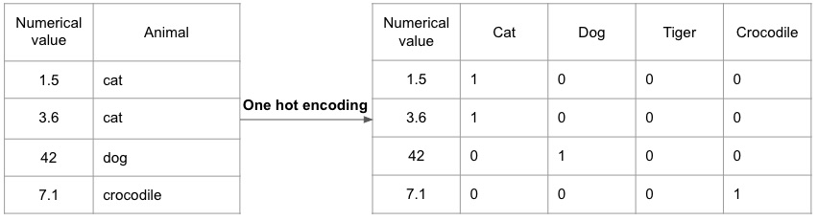
One-hot Encoding:
In One Hot Encoding, make sure the encodings are done in a way that all features are linearly independent. Replace the categorical variable by different Boolean variables (0/1) to indicate whether or not certain label is true for that observation.

Slide 21
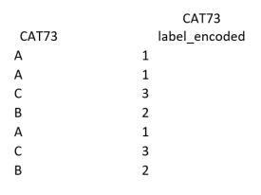
Label Encoding:
In this encoding each category is assigned a value from 1 through N (here N is the number of category for the feature). It may look like (Car<Bus<Truck ….0 < 1 < 2). Categories that have some ties or are close to each other lose some information after encoding.

Slide 22
Feature Generation:
Creating new features as a combination of existing ones. It's a great way to add domain knowledge to the dataset.
Feature Cleaning
Discretization
Reframe Numeric Quantities
Decompose
Crossing

Slide 23
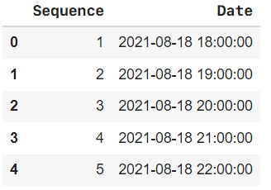
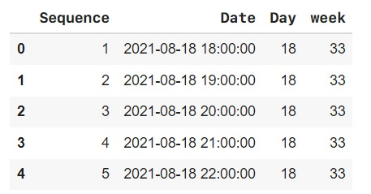
Decompose:
Converting 2014-09-20T20:45:40Z into categorical attributes like hour_of_the_day, part_of_day, etc.

Slide 24
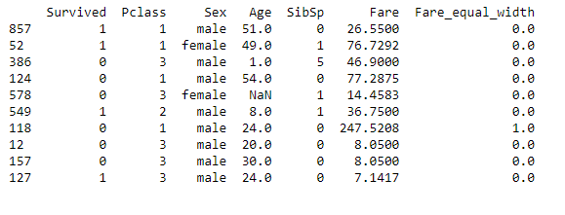
Discretization:
Continuous Features: Typically, data is discretized into partitions of K equal lengths/width (equal intervals) or K% of the total data (equal frequencies).
Categorical Features: Values for categorical features may be combined, particularly when there’s few samples for some categories.

Slide 25
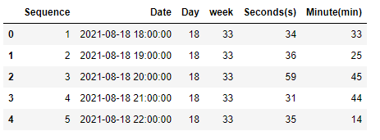
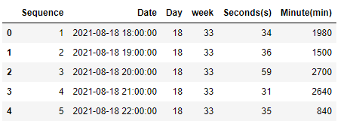
Reframe Numerical Quantities:
Changing from grams to kg and losing detail might be both wanted and efficient for calculation.

Slide 26
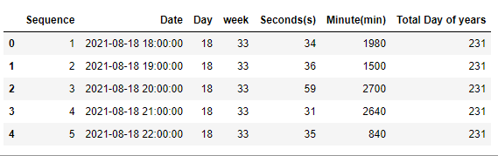
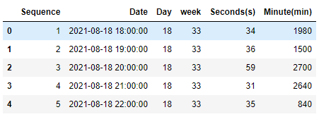
Crossing:
Creating new features as a combination of existing features. Could be multiplying numerical features or combining categorical variables. This is a great way to add domain expertise knowledge to the dataset.

Slide 27
Thank you!

